Slide 1
Analyzing the Impact of School Count and Crime Rate on Housing Prices in Aotearoa
Group Members:
Emma MARIE (68268218)
Sarah OONG (96301834)
Huaipu (Levo) WANG (28629644)
Jingcheng (Jacci) ZHOU (82204407）

Slide 2
CONTENTS
01
02
Relational Data Model
Introduction
+
Data Sources
03
04
Data Wrangling
Data Visualization
+
Conclusion

Slide 3
INTRODUCTION
Housing Price
High Housing Loan Rate
Impact on Our Life
Factors: Crime Rate and School
Homebuyers Investors

Slide 4




DATA SOURCES
01
02
03
04
05
Territorial Authorities Shapefile data
Crime data
Housing price data
School directory data
Population data

Slide 5
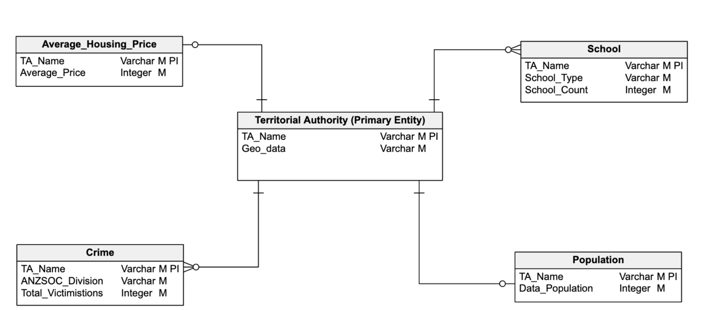
RELATIONAL DATA MODEL

Slide 6
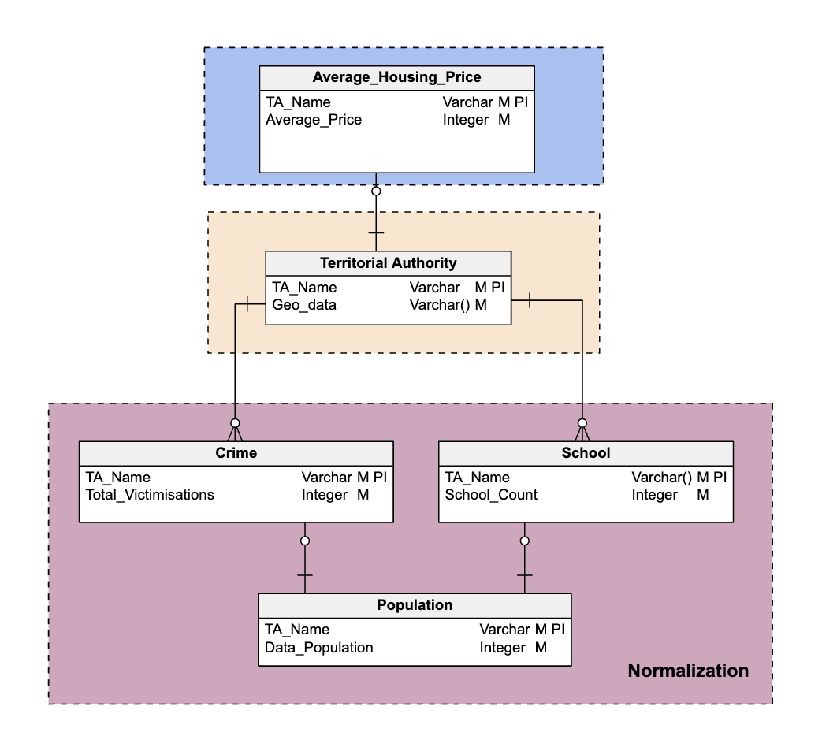
TABLE JOIN

Slide 7

DATA WRANGLING
Four Important Steps We Follow
DATA
DISCOVERY
STRUCTURE
and
CLEAN DATA
VALIDATE
and
CHECK DATA CONSISTENCY
PUBLISH
and
OUTPUT

Slide 8

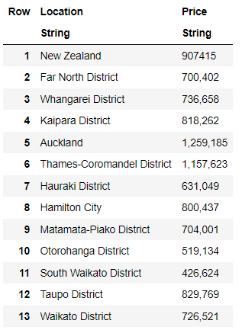
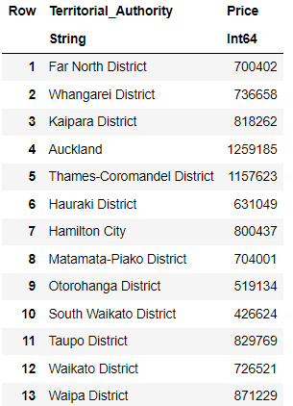
HOUSING PRICE
Before
After
Techniques Employed:
Scraping - using “HTTP” package
Data Cleaning - using “DataFrames” package
Save clean data to csv - using “CSV” package

Slide 9

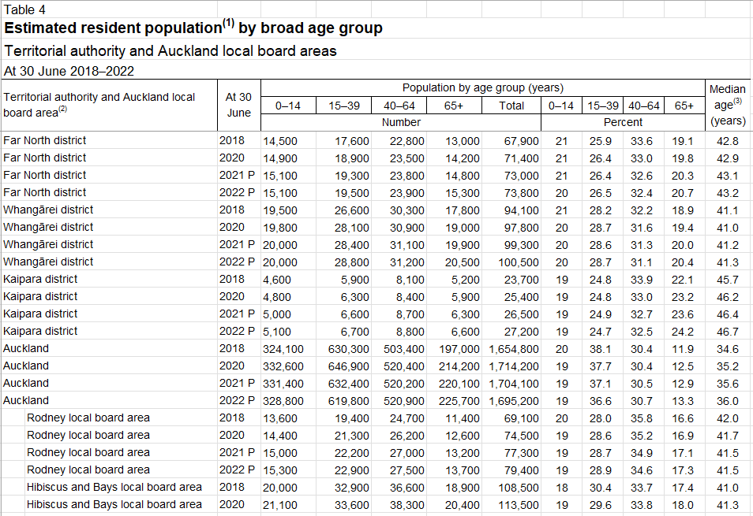
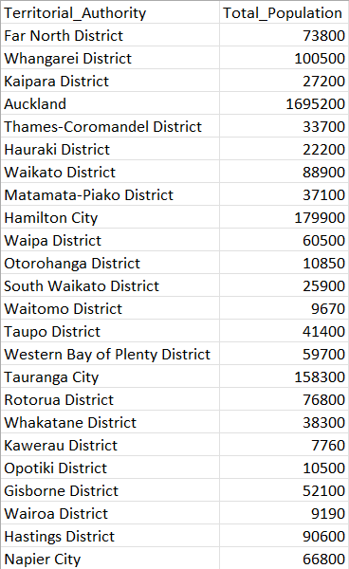
POPULATION
Before
After
Techniques Employed:
Load the data - using “readxl” package
Data Cleaning - using “tidyverse” package
Save clean data to csv - using “tidyverse” package

Slide 10

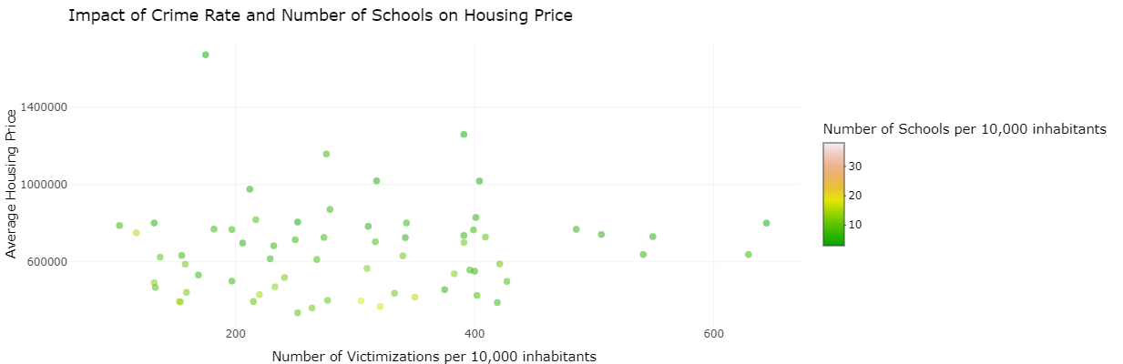
R SHINY VISUALIZATION

Slide 11

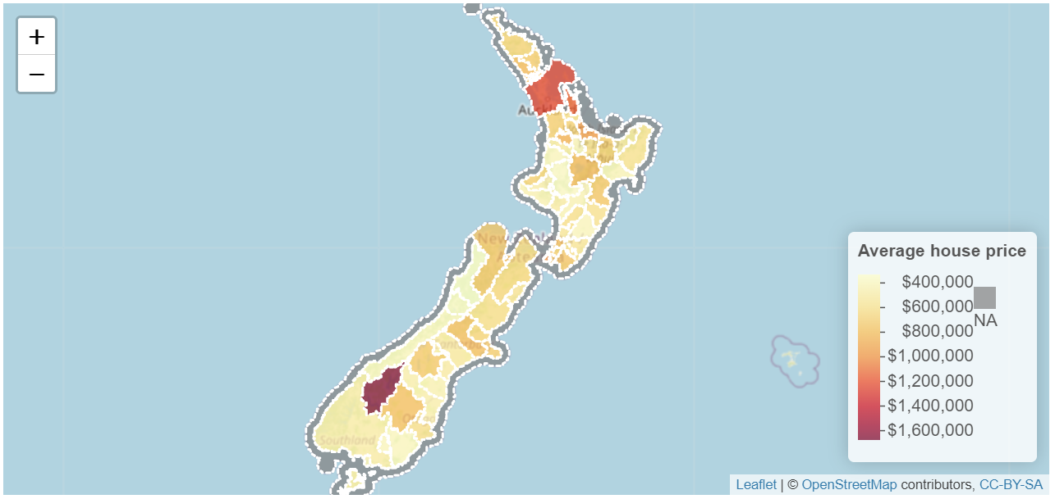
R SHINY VISUALIZATION
AVERAGE HOUSE PRICE

Slide 12
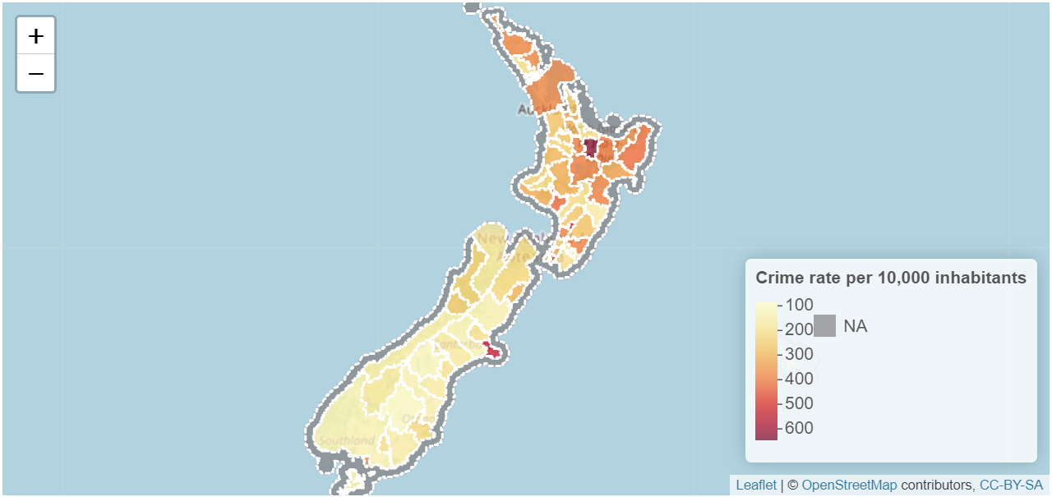
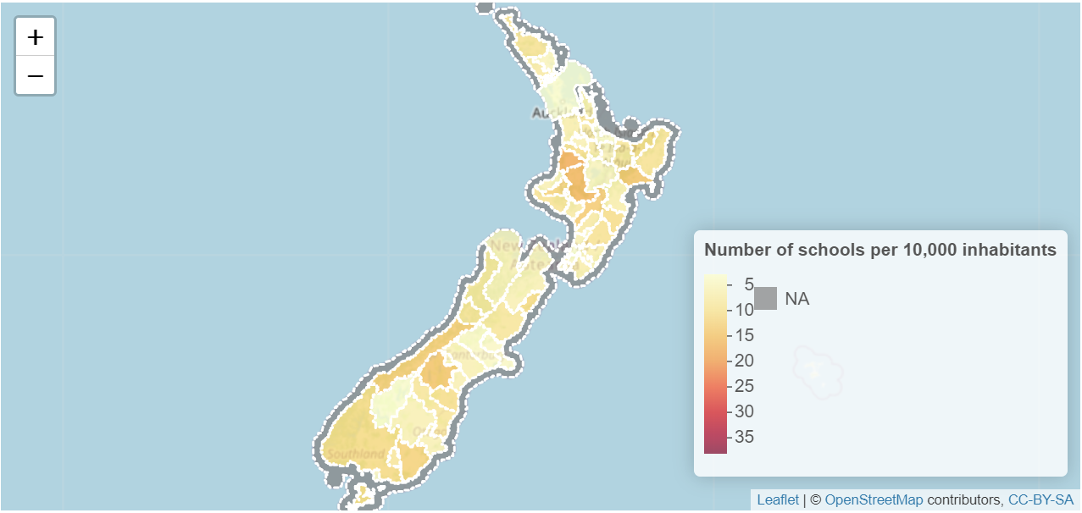
R SHINY VISUALIZATION
CRIME RATE PER 10,000 INHABITANTS
NUMBER OF SCHOOLS PER 10,000 INHABITANTS

Slide 13
CONCLUSION
PROJECT IDEA + DATA SOURCES
DATA COLLECTION +
RELATIONAL DATA MODEL
DATA
WRANGLING
VISUALIZATIONS
PRESENTATION AND REPORT

Slide 14
THANK YOU
Does anyone have any questions?

